Slide 1
NLP

Slide 2
Text similarity
Introduction

Slide 3
Text Similarity
Motivation
People can express the same concept (or related concepts) in many different ways. For example, “the plane leaves at 12pm” vs “the flight departs at noon”
Text similarity is a key component of Natural Language Processing
Uses in NLP
If the user is looking for information about cats, we may want the NLP system to return documents that mention kittens even if the word “cat” is not in them.
If the user is looking for information about “fruit dessert”, we want the NLP system to return documents about “peach tart” or “apple cobbler”.
A speech recognition system should be able to tell the difference between similar sounding words like the “Dulles” and “Dallas” airports.

Slide 4
Types of Text Similarity
Many types of text similarity exist:
Morphological similarity (e.g., respect-respectful)
Spelling similarity (e.g., theater-theatre)
Homophony (e.g., raise-raze-rays)
Synonymy (e.g., talkative-chatty), including across languages
Semantic similarity (e.g., cat-tabby)
Sentence similarity (e.g., paraphrases)
Document similarity (e.g., two news stories on the same event)

Slide 5
Human Judgments of Similarity
tiger cat 7.35
tiger tiger 10.00
book paper 7.46
computer keyboard 7.62
computer internet 7.58
plane car 5.77
train car 6.31
telephone communication 7.50
television radio 6.77
media radio 7.42
drug abuse 6.85
bread butter 6.19
cucumber potato 5.92
[Lev Finkelstein, Evgeniy Gabrilovich, Yossi Matias, Ehud Rivlin, Zach Solan, Gadi Wolfman, and Eytan Ruppin, "Placing Search in Context: The Concept Revisited", ACM Transactions on Information Systems, 20(1):116-131, January 2002]
http://wordvectors.org/suite.php

Slide 6
Human Judgments of Similarity
delightful wonderful A 8.65
modest flexible A 0.98
clarify explain V 8.33
remind forget V 0.87
get remain V 1.6
realize discover V 7.47
argue persuade V 6.23
pursue persuade V 3.17
plane airport N 3.65
uncle aunt N 5.5
horse mare N 8.33
[SimLex-999: Evaluating Semantic Models with (Genuine) Similarity Estimation. 2014. Felix Hill, Roi Reichart and Anna Korhonen. Preprint pubslished on arXiv. arXiv:1408.3456]

Slide 7
Automatic Similarity Computation
spain 0.679
belgium 0.666
netherlands 0.652
italy 0.633
switzerland 0.622
luxembourg 0.610
portugal 0.577
russia 0.572
germany 0.563
catalonia 0.534
Words most similar to “France”
Computed using word2vec
[Mikolov et al. 2013]

Slide 8
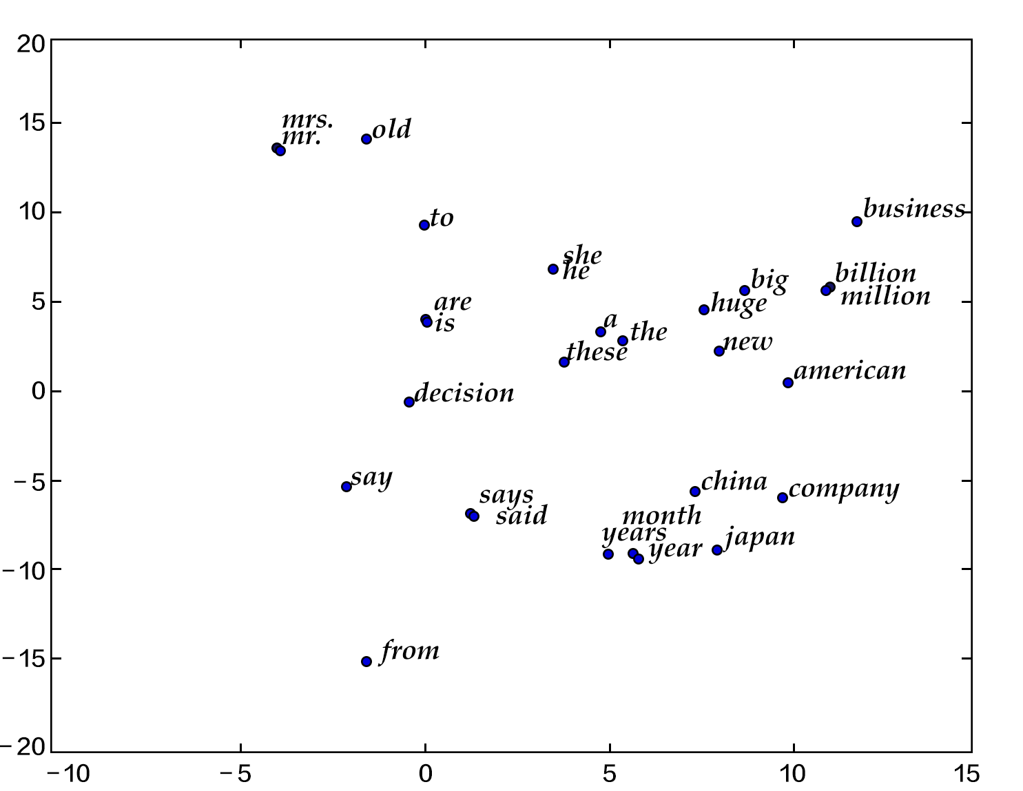

Slide 9
NLP

